Slide 1
Chapter 8
Maintaining RMAN Backups and the Repository

Slide 2
Objectives
High-level recommendations
Adding user backups
Finding files that need backups
Finding obsolete backups
Displaying and listing backup information
Updating repository after manual deletion
Synchronizing repository

Slide 3
Objectives (cont.)
Deleting backups & archived redo logs
Deleting obsolete backups
Changing backup status
Changing archival backup status
Testing integrity of backups
Backup validation

Slide 4
Basic Recommendations
Use the flash recovery area
Have an archived redo log deletion policy
Employ a backup retention policy
Validate your backups

Slide 5
Adding User Backups to Repository
Done via catalog command
Can use as level 0 incremental backup
Backups initially done with O/S command
Files must be available on disk
Must be complete image copy of:
  Single datafile
  Control file
  Archived redo log file
  Backup piece
‘Catalog start’ command can backup multiple files
‘Catalog recovery area’ catalogs flash recovery area

Slide 6
Finding Files That Need a Backup
Use ‘report need backup’ command
Reports files out of compliance with retention policy
For datafiles and archived redo logs
Several variations of ‘report need backup’:

Slide 7
Files That Need Backup Due to Unrecoverable operations
Use ‘report unrecoverable’ command
Unrecoverable operation examples:
  Direct load insert
  Nologging operations

Slide 8
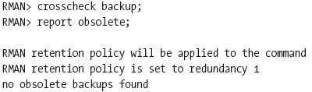

Identifying Obsolete Backups
Done via ‘report obsolete’ command
Always run ‘crosscheck backup’ first
Other options of report obsolete:

Slide 9
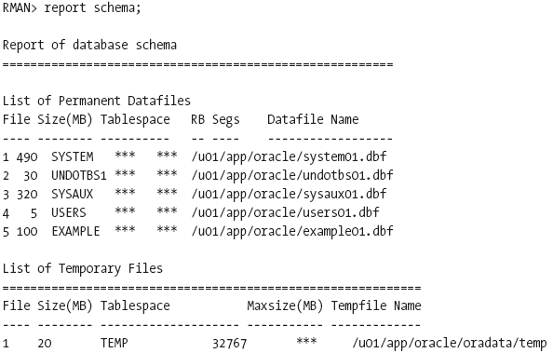
Displaying Datafile Information
Done via ‘report schema’ command
Displays information about datafiles in target database
Can get information for a past point-in-time

Slide 10
Listing RMAN Backups
Done via ‘list’ command
Done to review backups of:
  Backup pieces / Image copies
  Proxy copies of databases
  Tablespaces
  Datafiles
  Archived redo logs
  Control files
  Expired backups
  By backup classification (e.g. time period, device)
Can list backups by file

Slide 11

Listing Expired Backups
For backups not found using ‘crosscheck’
Use ‘list expired backup’ command
Can find expired archive logs

Slide 12
Listing Only Recoverable Entities
To list all datafile backups and copies that can be used for restore & recovery
Lists all restore points or specific restore point
Done via ‘list recoverable backup’ command

Slide 13
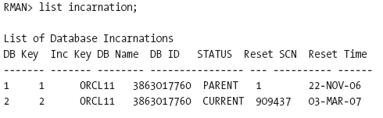
Listing Database Incarnation
To list databases across ‘resetlogs’
Done via ‘list incarnation’ command

Slide 14
Updating Repository After Manual Backup Deletion
Done via ‘change . . . uncatalog’ command
Changes only repository
Doesn’t delete physical backups and copies
Execute after deleting files with O/S command

Slide 15
Synchronizing Repository
To synchronize with actual backups/copies
Run ‘crosscheck’ command
  Output file status can be one of three:
    Available
    Unavailable
    Expired
Synchronization not needed often if using:
May also need to run ‘delete expired backup’
  Backup retention policy
  Archived redo log deletion policy
  Flash recovery area

Slide 16
Deleting Backups
Done via ‘delete backup’ command
What ‘delete backup’ really does:
  Removes physical backup files from media
  Marks status as deleted
  Deletes rows from recovery catalog (if used)
Primary options for ‘delete backup’:
  Force, expired, obsolete
RMAN prompts for deletion confirmation
  Use ‘noprompt’ option to suppress

Slide 17


Deleting Archived Redo Logs
Done via ‘delete archivelog all’ command
Can delete after a backup
Use ‘configure archivelog deletion policy’ command to specify criteria

Slide 18
Deleting Obsolete Backups
Done via ‘delete obsolete’ command
Relies on in force backup retention policy
Archived redo log deletion policy not considered
Can delete based on unconfigured policy:
Understand impacts of ‘keep until’ clause
  Doesn’t override configured retention policy, if shorter
  Backups are kept, if longer than configured policy

Slide 19
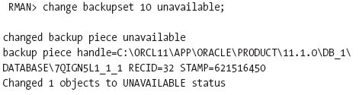
Changing Backup Status
Done via ‘change . . . unavailable’ command
Use if backups off-site or can’t be found
Is alternative to uncataloging backups
Can change the backup back to available

Slide 20

Changing Archival Status
To change status of a long-term backup
Done via ‘change’ command
Using ‘keep forever’ or ‘keep until time’ means backup not subject to normal retention policy
Recovery catalog needed for ‘keep forever’
Using ‘nokeep’ means backup again is subject to retention policy

Slide 21
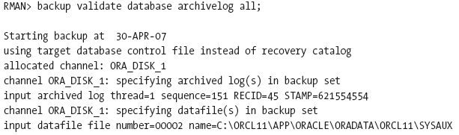

Testing Integrity of Backup
Done via ‘backup validate’ command

Slide 22
Backup Validation
For validation of:
  Datafiles
  Backup Sets
  Data Blocks
Done via ‘validate’ command
More granular than ‘backup … validate’
For blocks, only checks intrablock corruption
Can parallelize with ‘section size’ clause

